Slide 1
Sample Presentation

Slide 2
Introduction
A visual Exploration of my work environment
Test the functionality of generating PDFs and extracting text from Microsoft word documents

Slide 3
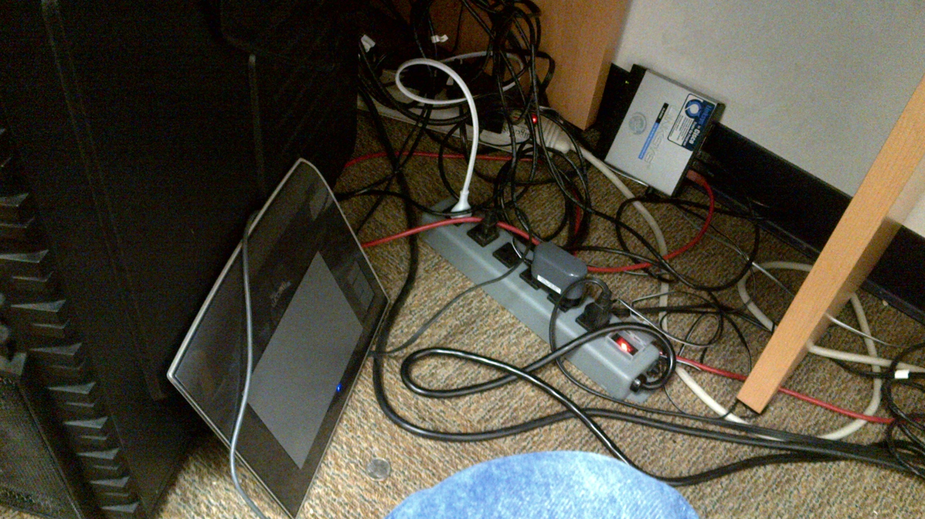
Wiring below the desk

Slide 4
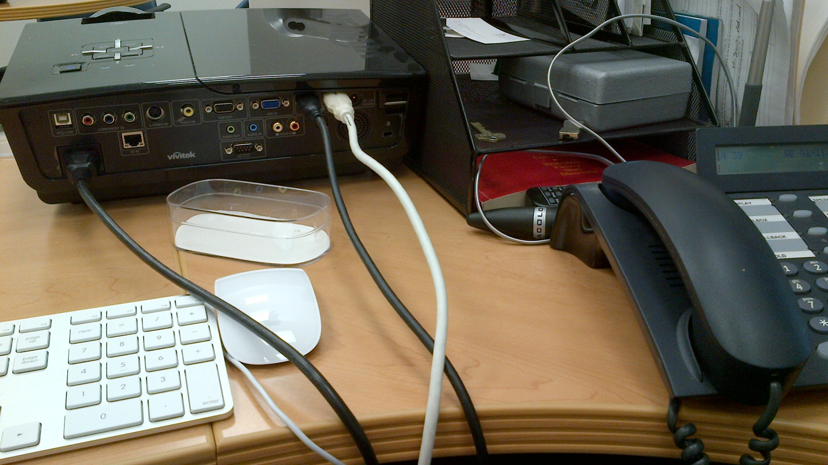
Projector

Slide 5
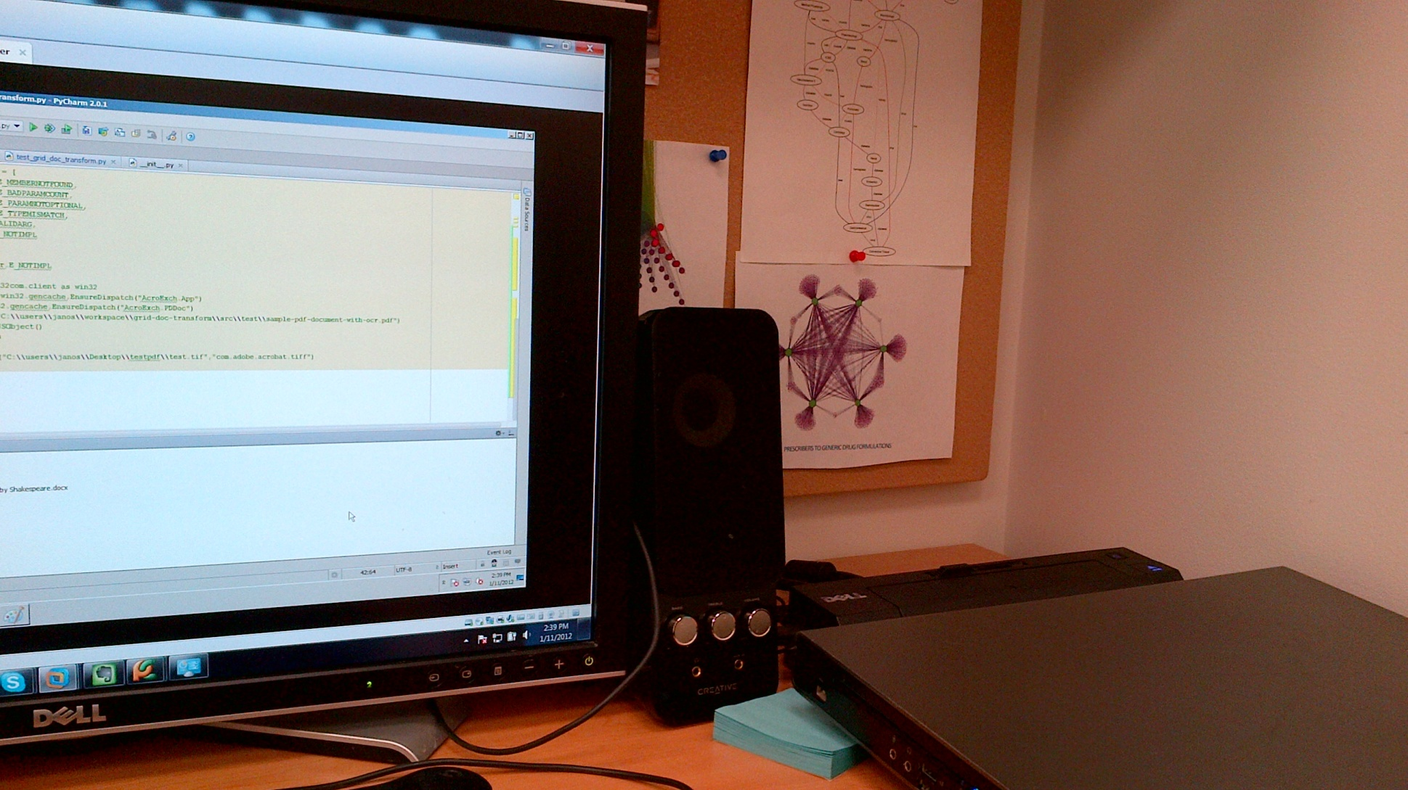
Monitor

Slide 6
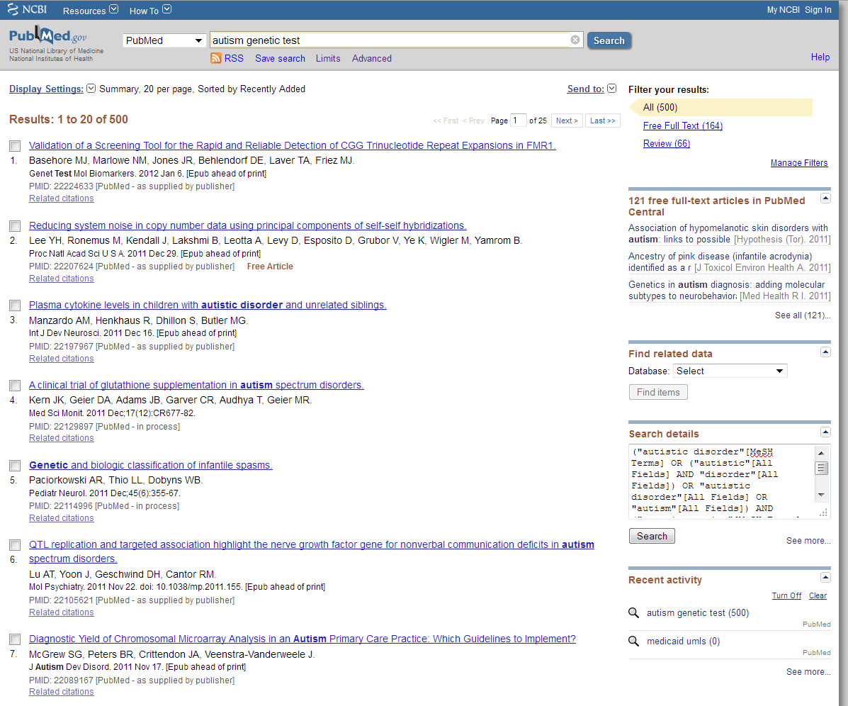
Random screen grab

Slide 7
Conclusions
There are a large number of wires under my desk
The wires run in different directions
If I did things simply I would not need all those wires

